Slide 1


Web 3 developers Overview
Emerging Blockchain developers Continue to Contribute While Many Newcomers Have Left
We can segment monthly active developers by how long they have worked in web3 by comparing the time between their first and last commits.
Newcomers: developers who worked in web3 less than 1 year
Emerging Developers: developers who worked in web3 1 to 2 years
Established Developers: developers who worked in web3 2+ years
Emerging Developers are growing and Established Developers are steady. The decline in monthly active developers in the last year came from Newcomers.
From June 2023 to June 2024:
-52% Newcomers (-9K developers)
-1% Emerging Developers (-84 developers)
+33% Established Developers (+2K developers)

Slide 2
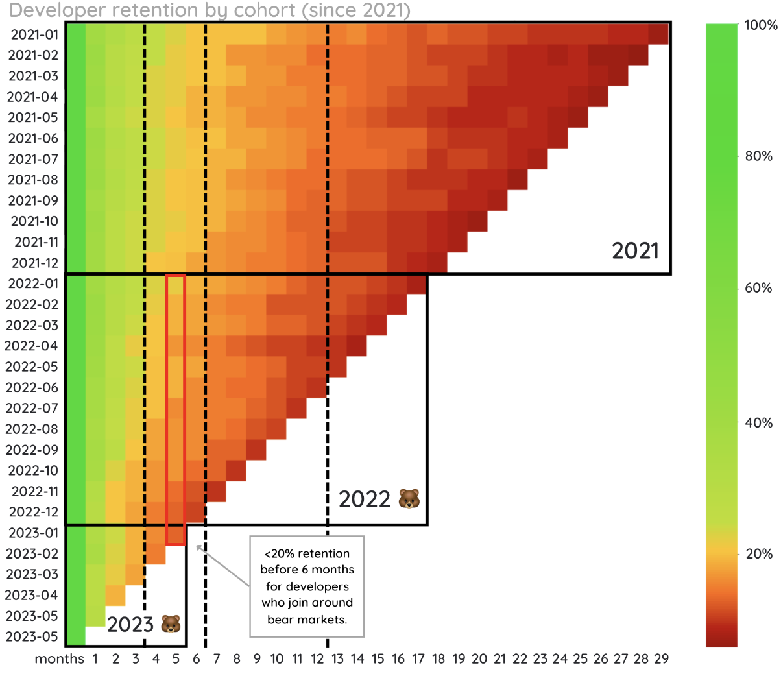
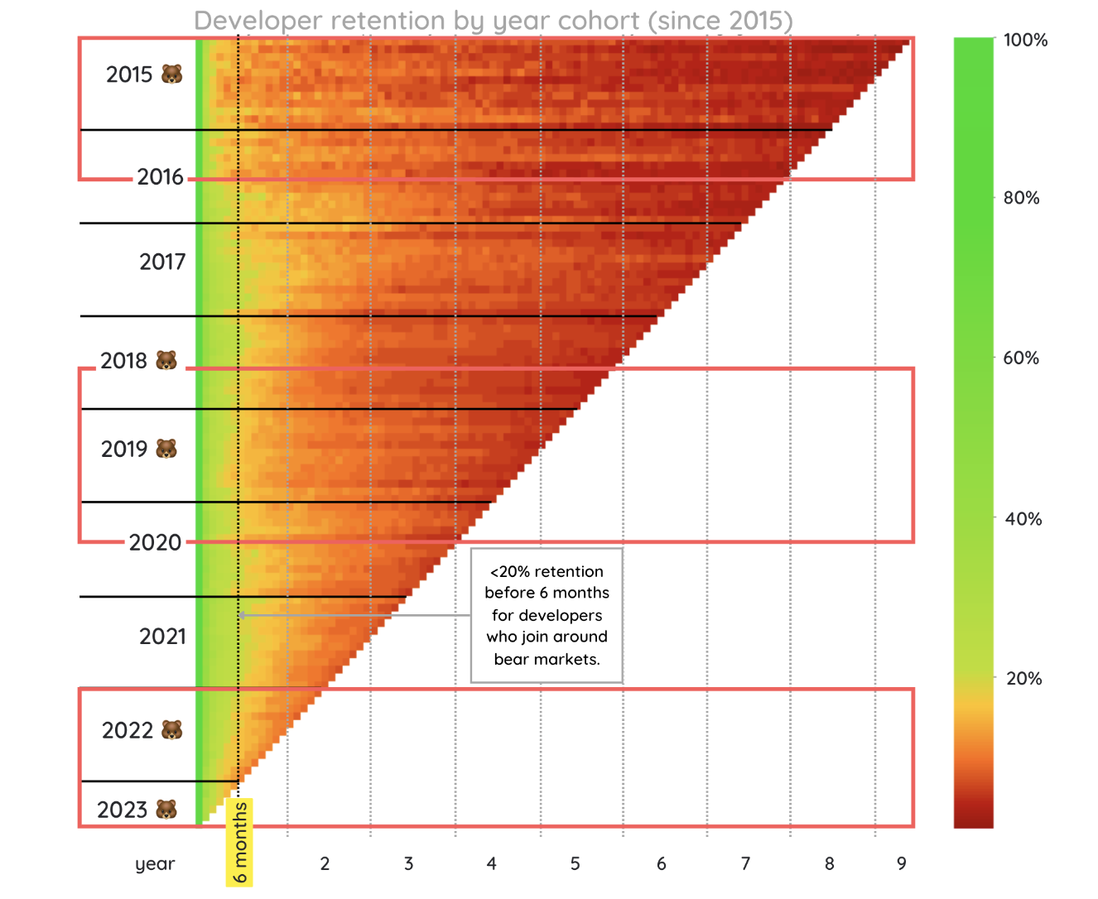
Web 3 developers Overview

Slide 3
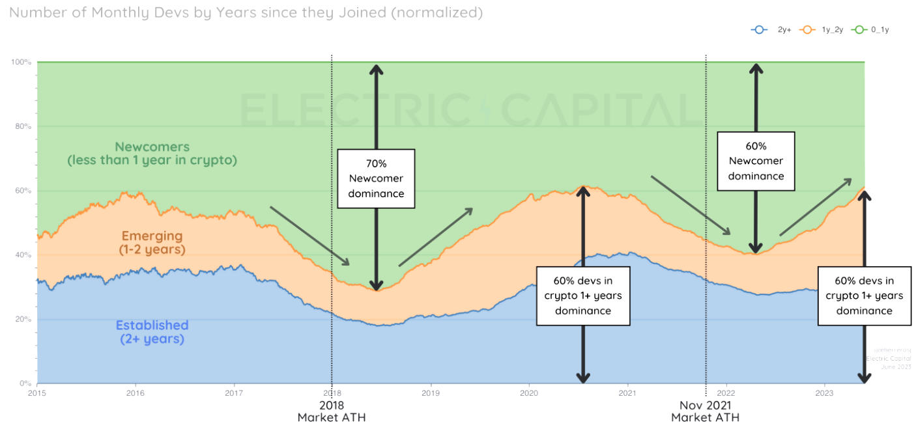
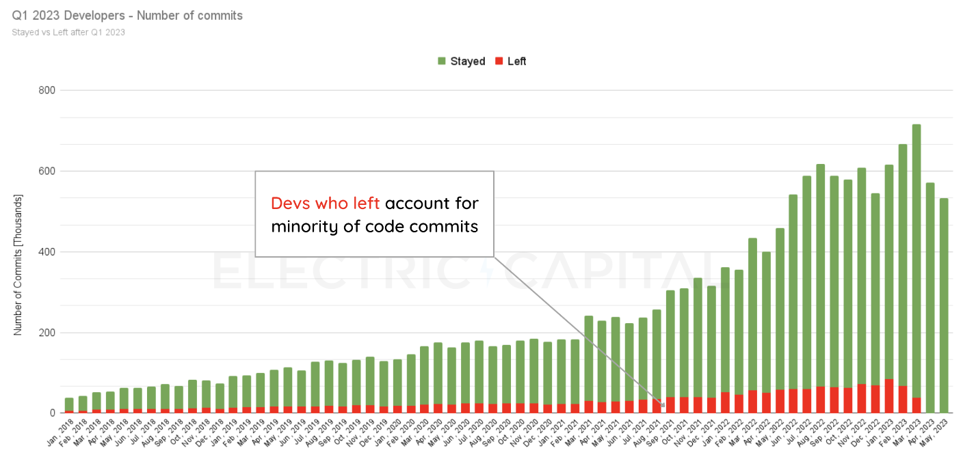
Web 3 developers Overview

Slide 4
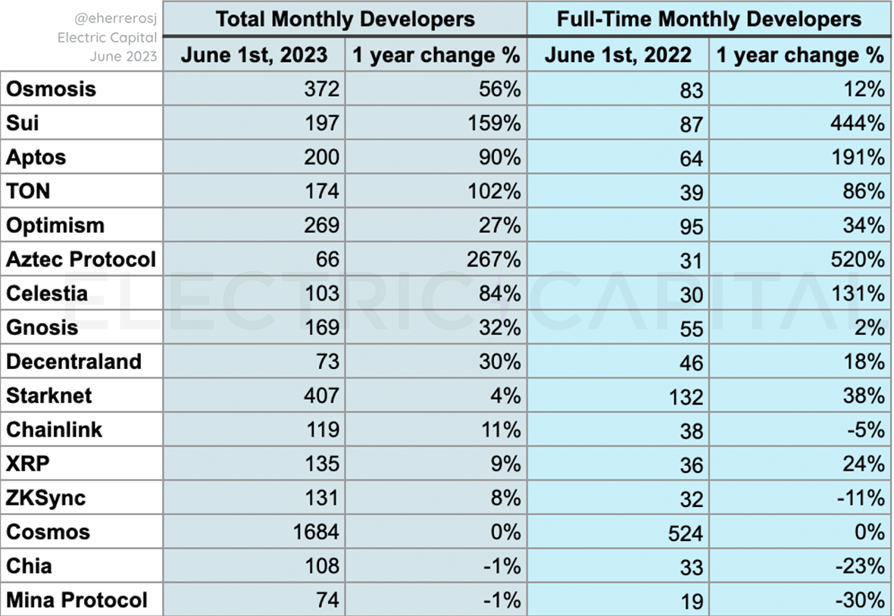
Web 3 developers Overview
Ecosystems with highest growth in monthly developers (June 2023 vs June 2022).

Slide 5
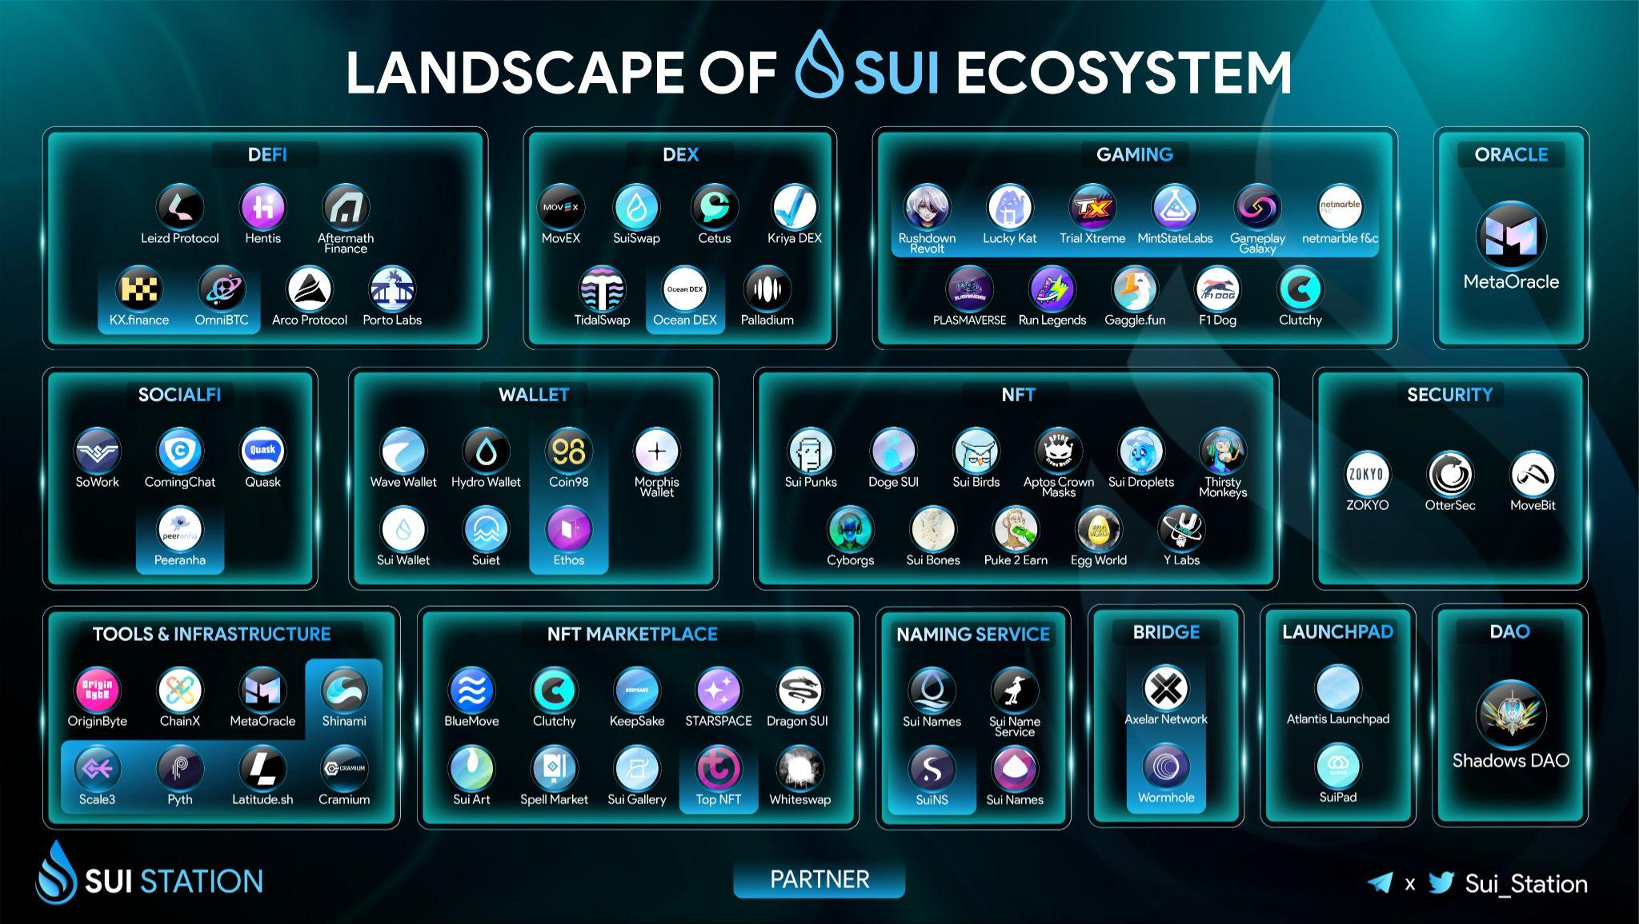
Ecosystem Overview
360+ Projects building
upon Sui.
Wide-Array of dAAps
ranging from:
NFT, Gaming, DeFi, DeSoc, Launchpads, Dex, Naming Services & Others.
+300 others

Slide 6
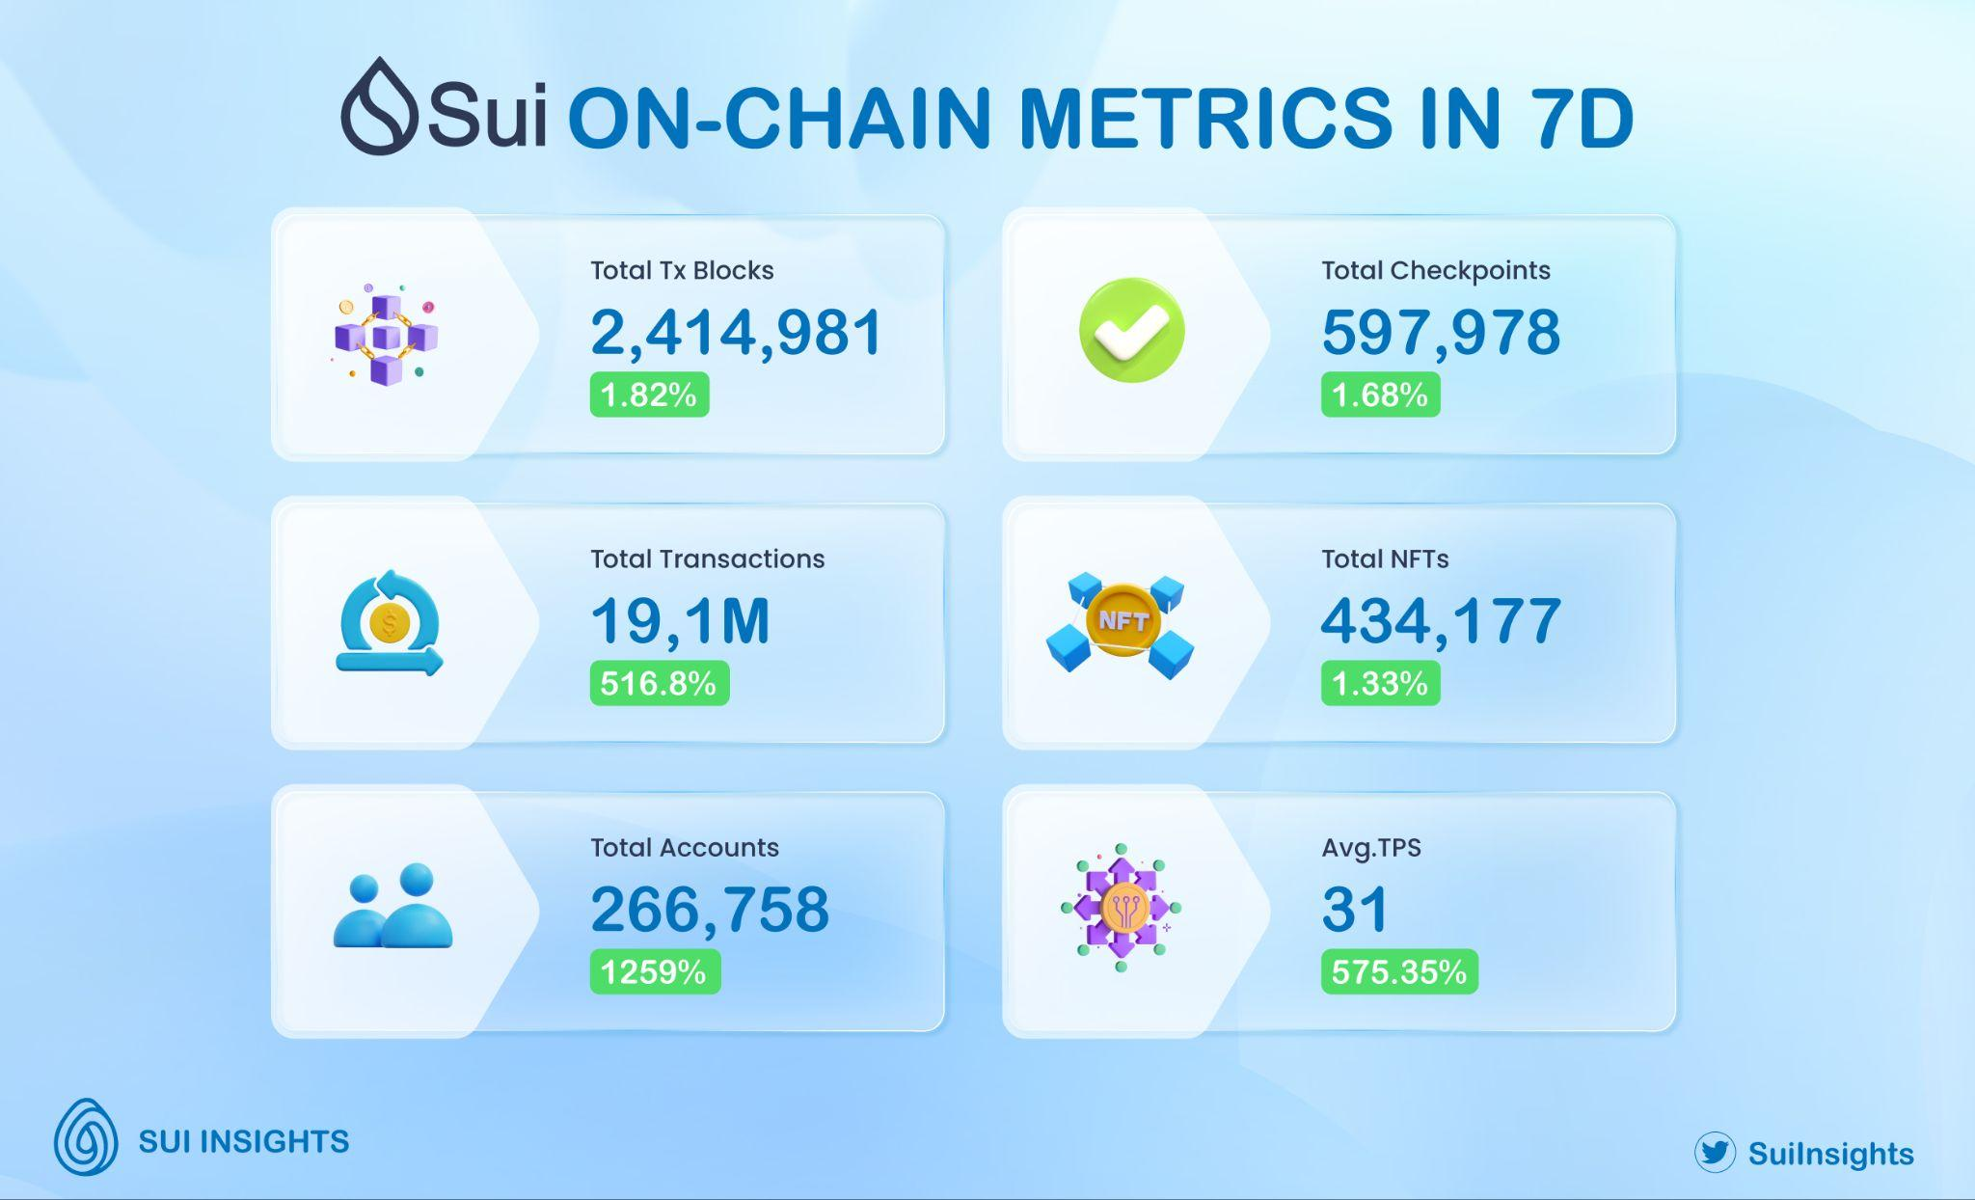
On-Chain Metrics
126.6m+ transactions since the mainnet launch.
80m+ Total Transaction Blocks
Current Market Cap
445m.
1.5M Registered Users, 955,000 Monthly active users
Source - Sui Explorer
Data from 27.6 - 4.7.2023

Slide 7
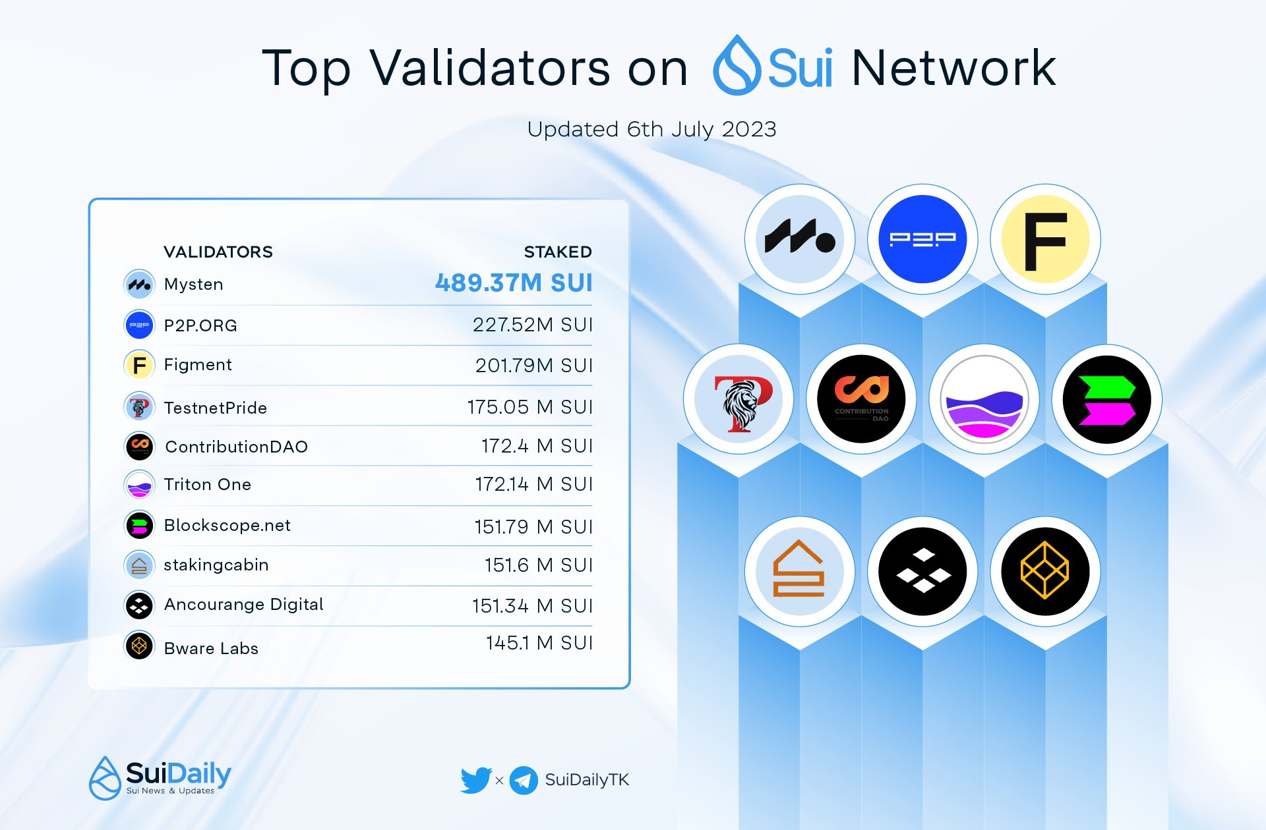
Validators
Total Number of Sui Staked:
7.44B by validators and Delegators.
Average APY of all participating validators:
5.33%
Number of Validators across the world: 104, spanned across 10 countries.
Source - Sui Explorer
Updated for 6th of July 2023

Slide 8
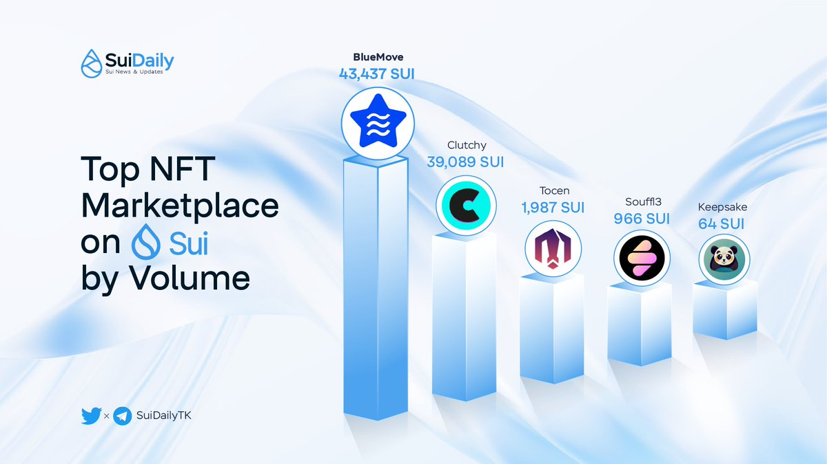
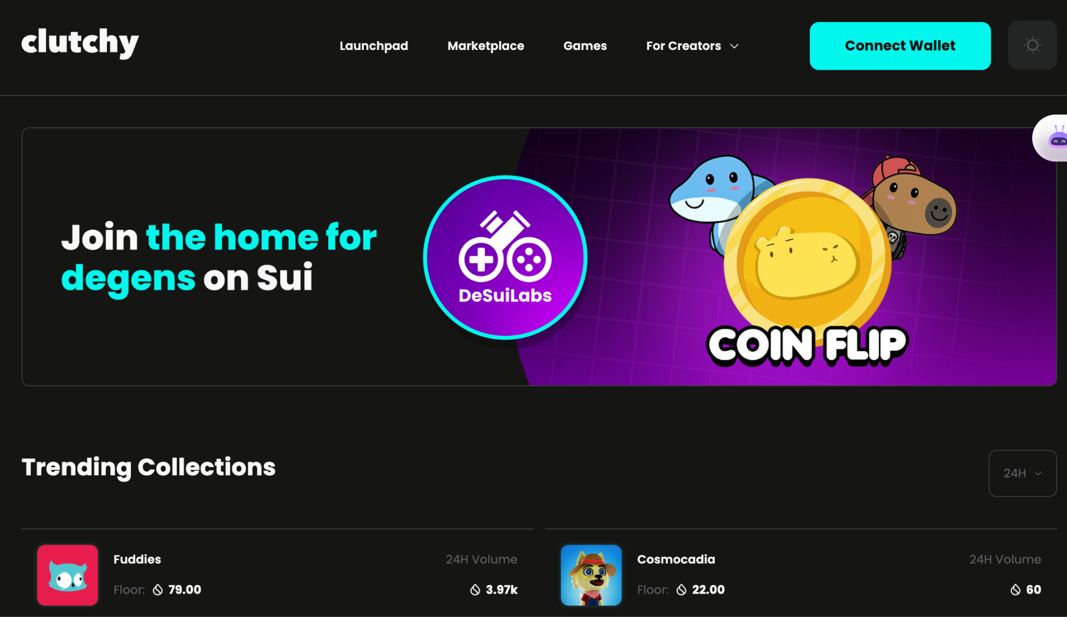
Sui x NFT Marketplaces
Sui has a thriving NFT space with multiple renowned NFT Marketplaces enabling users to buy, sell, create and trade their digital assets.
Some of the biggest Marketplaces currently active:
BlueMove, Souffl3, KeepSake,
Clutchy, Tocen
Clutchy: Biggest by volume (216k Sui Volume)

Slide 9
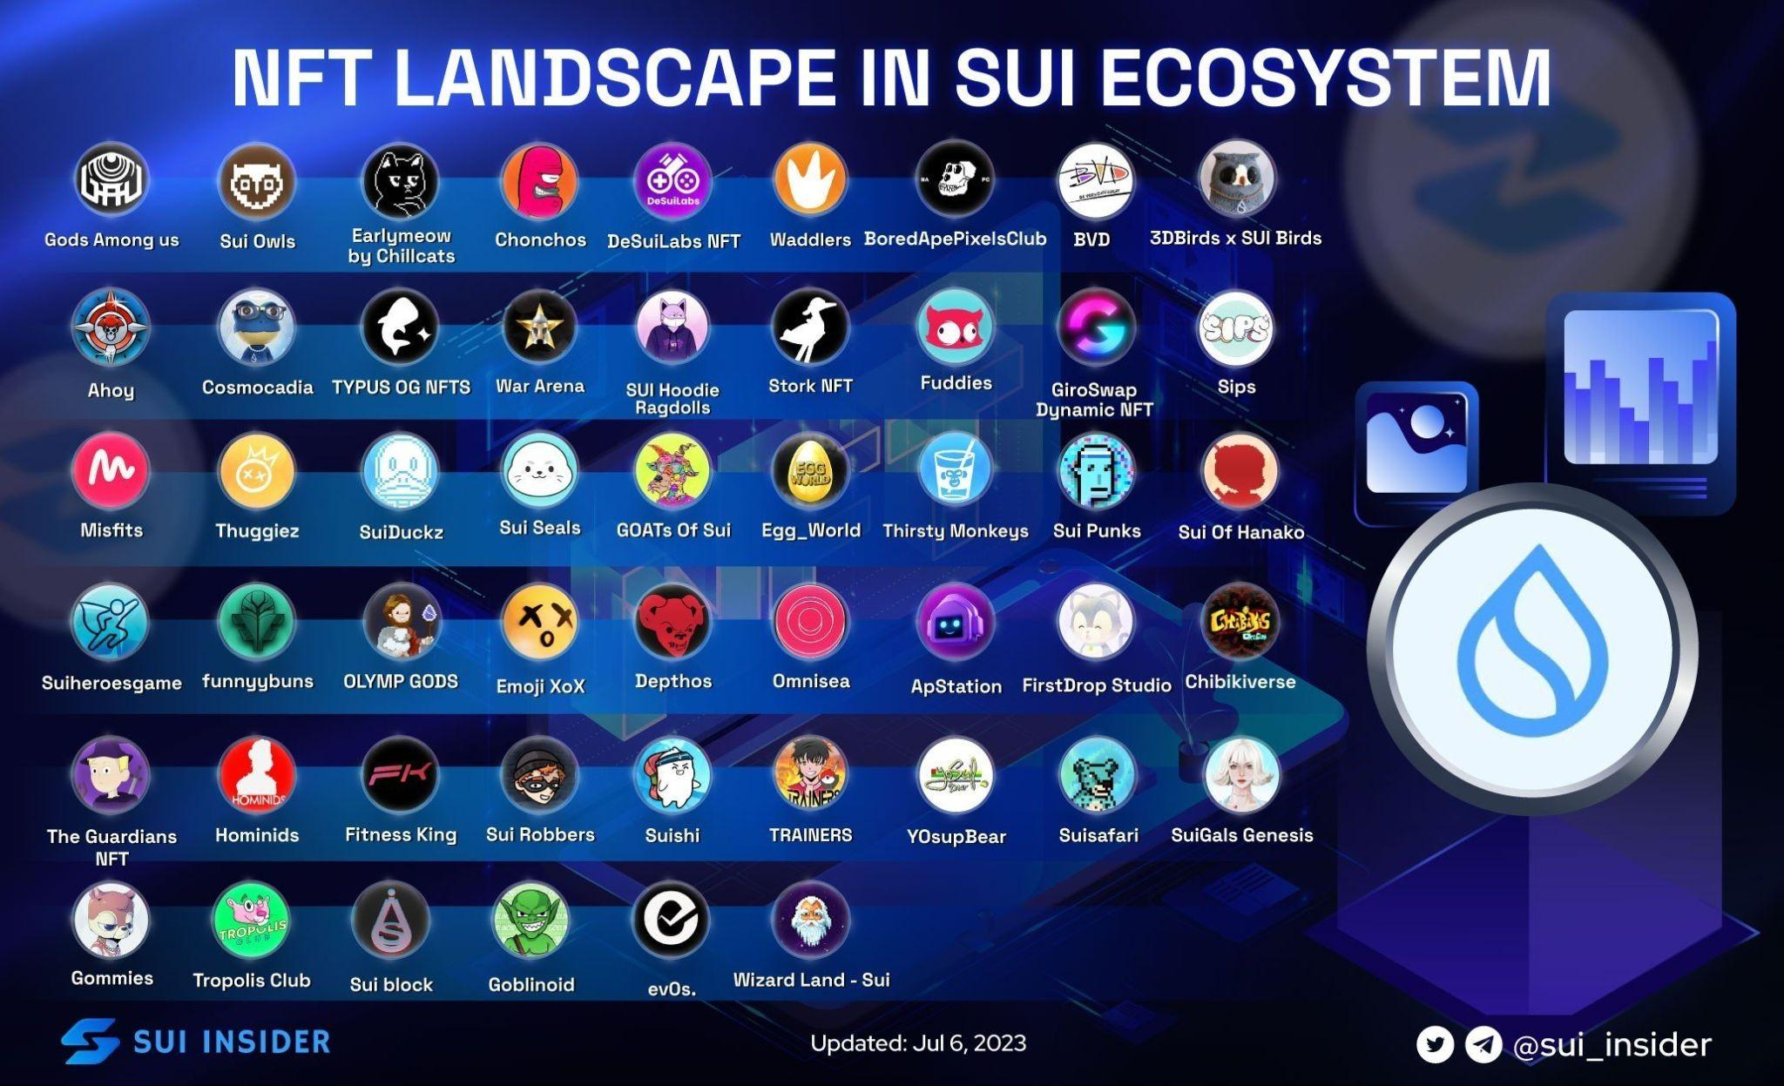
Sui x NFTs
Hundreds of Native Collections NFT and thousands of collectors, creators & artists building upon the NFT Ecosystem of SUI. →
Some of the renowned / new collections:
SuiFrens, Fuddies, DeSuiLabs.
More than 2.5M NFTs on-chain across different marketplaces with a total volume of 3.5M+ SUI
Multiple collections are creating dynamic and composable NFTs.
+Multiple others

Slide 10

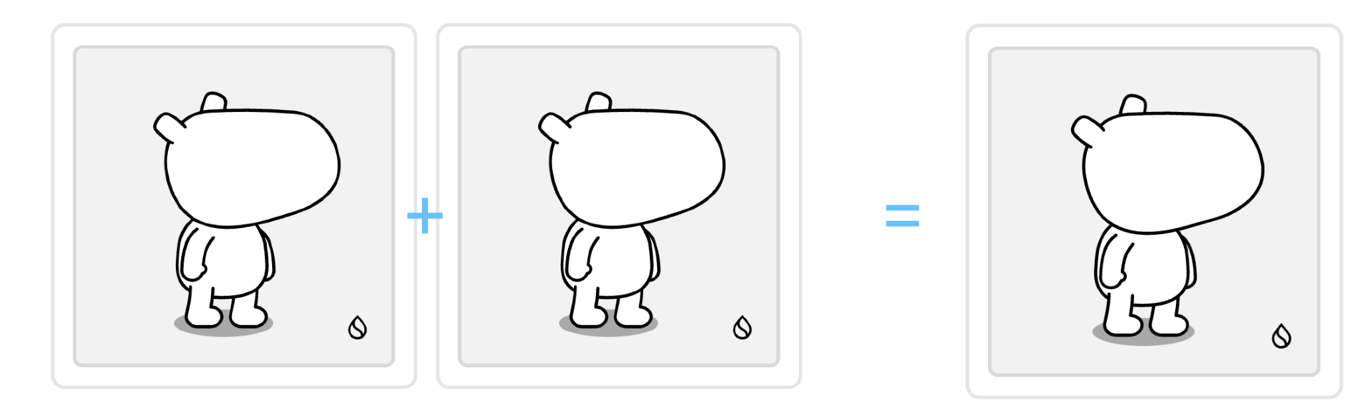
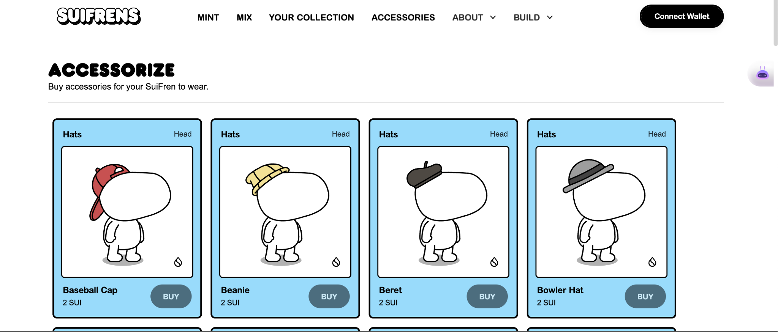
Sui x NFT - Example (SuiFrens)
NFT Collection native to the SUI ecosystem which is traversing the growing infrastructure of SUI Protocol.
Collection is interoperable with numerous dAAps and services across SUI Ecosystem.
Collection enables Mixing of NFTs & creation of new NFT based on the traits mixed.
Parent → Child (Inherited Traits)
SuiFrens also enables composable NFT Mechanics (Accessories on top of your digital asset)

Slide 11
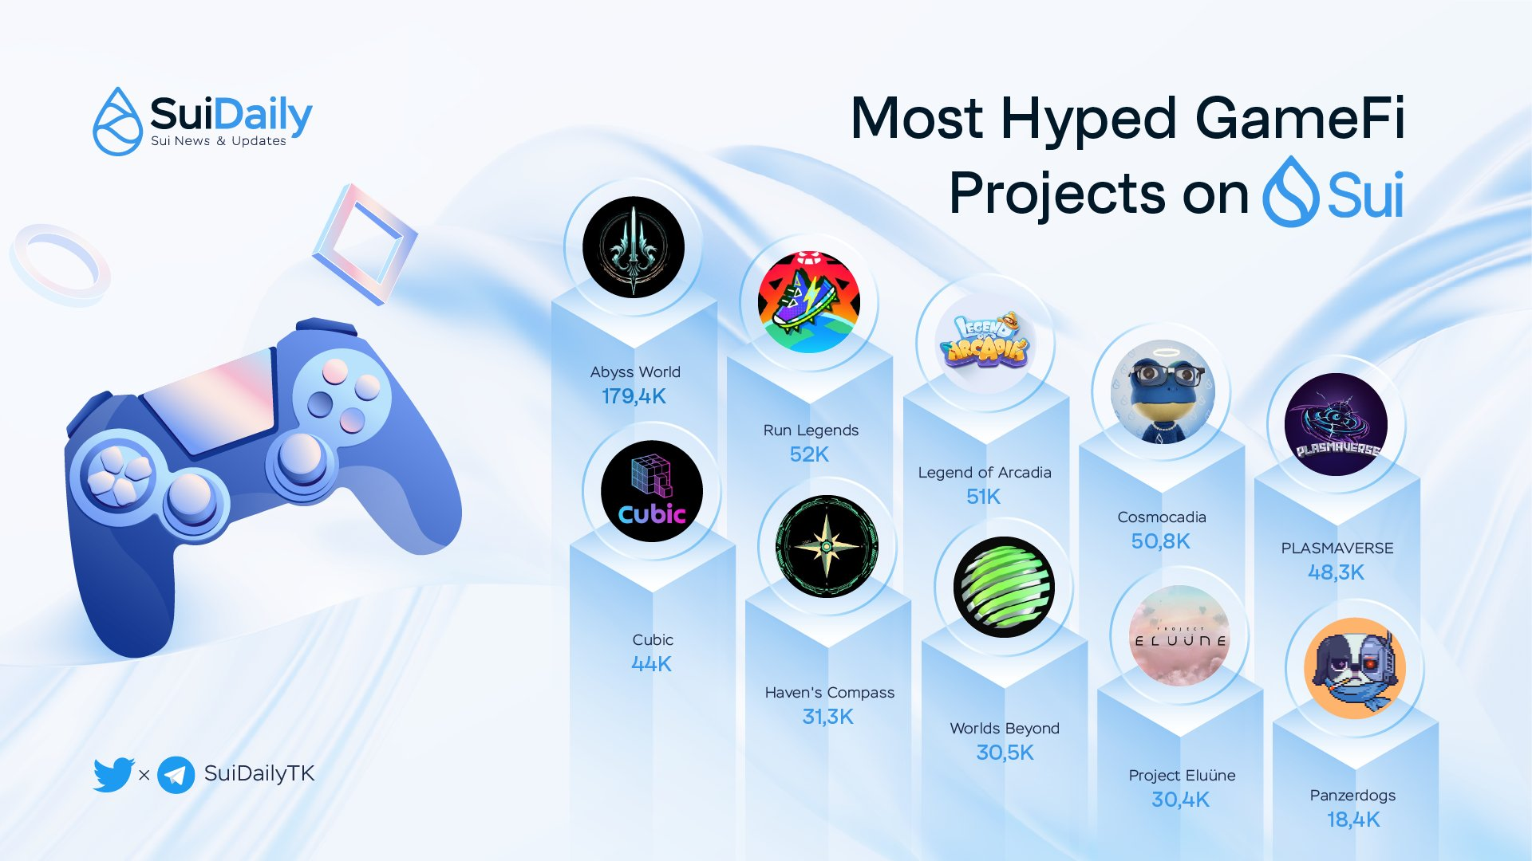
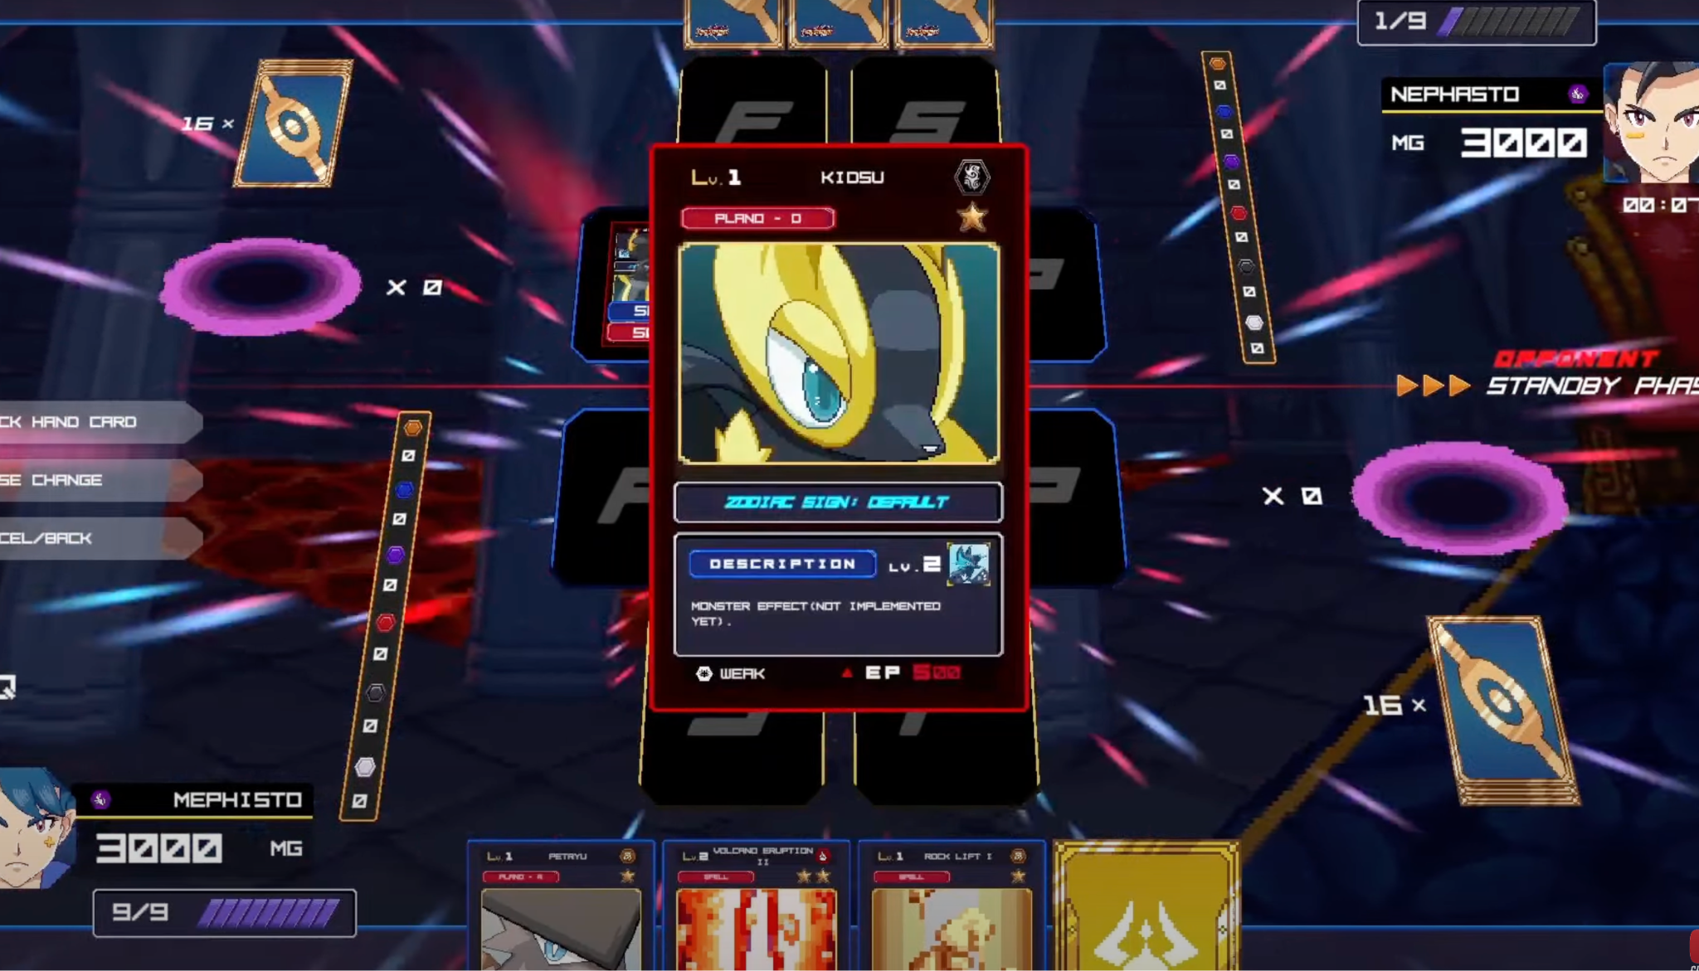

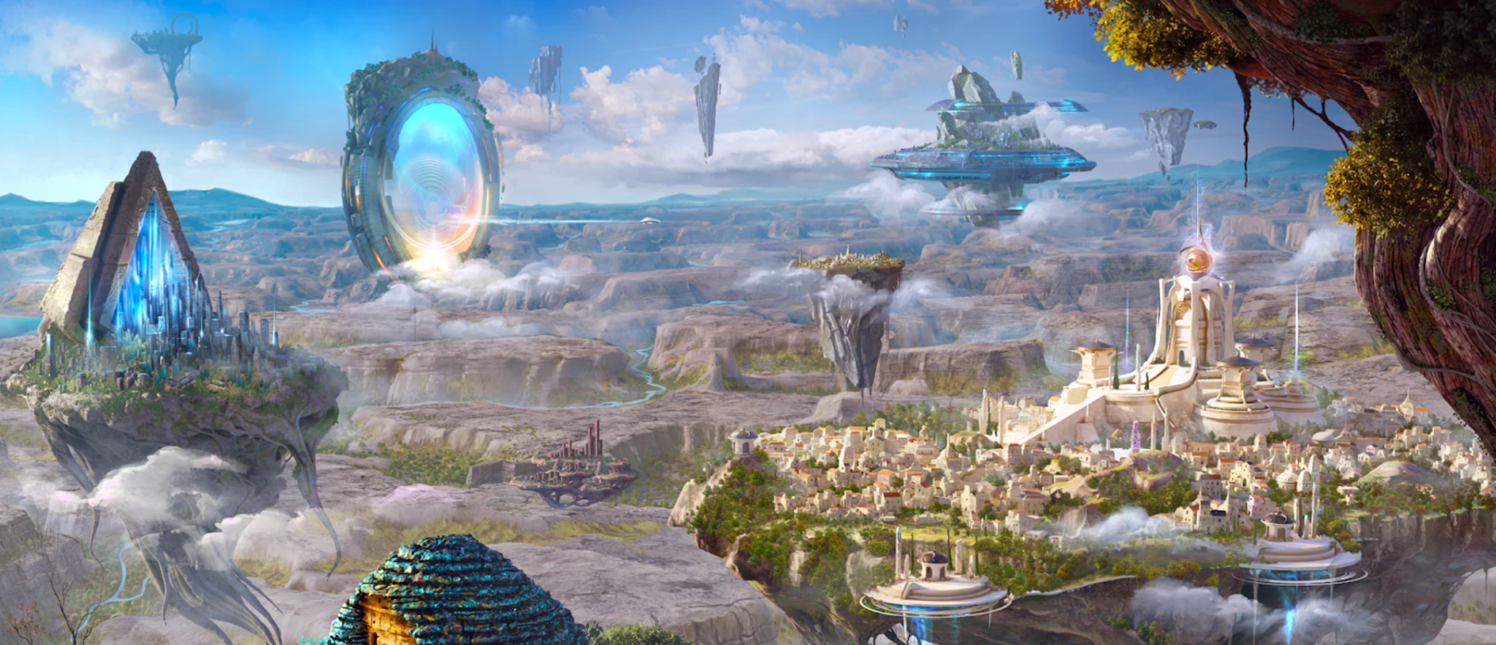
Sui x Gaming
Game-first approach, putting the emphasis on the player experiences, engagement while tying it with asset ownership.
More than 40+ established games ranging from Indie to AAA in the making by various game studios.
Composable Digital Assets within Games (Character Leveling)
Simple Transaction Execution (Transfer, Buy / Sell) Immediate.

Slide 12
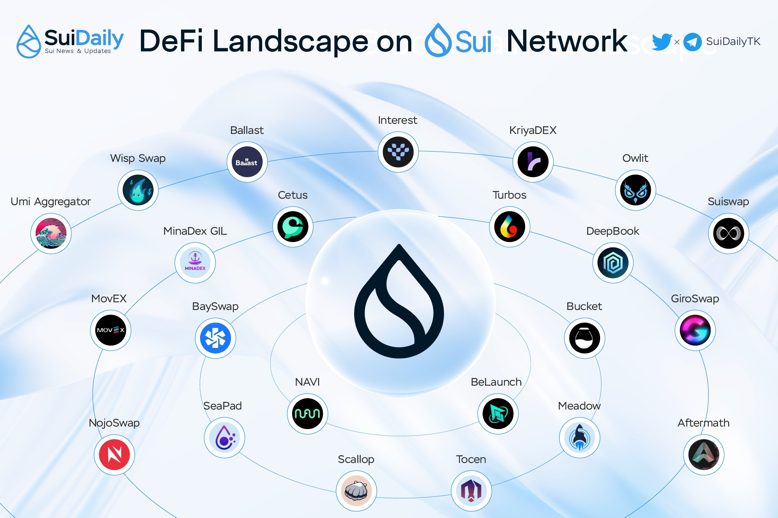
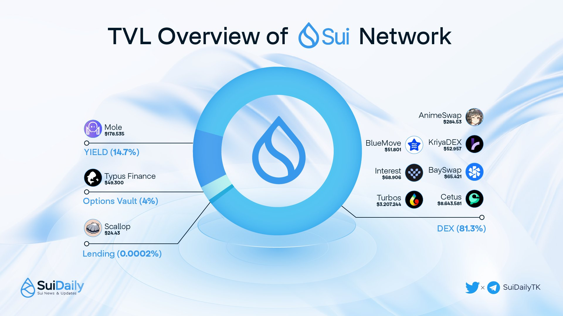
Sui x DeFi
With it’s near to instant settlements of transactions as well as the security, SUI is positioning itself as the new DeFi hub of crypto.
Multiple projects building upon the DeFi space of SUI.
13.09M+ Total Value Locked in different DeFi platforms.
DEX, Lending, Borrowing etc..
$836,000 transaction volume Approx (24h)

Slide 13
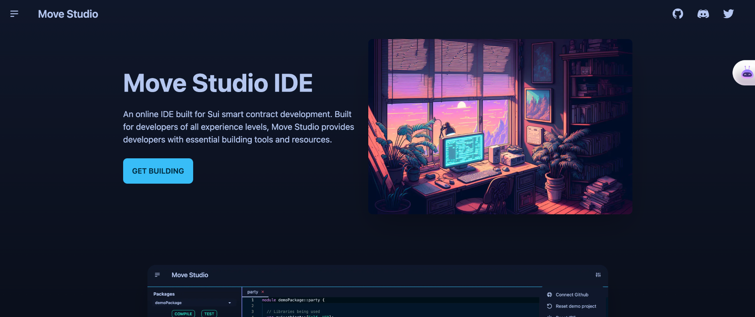
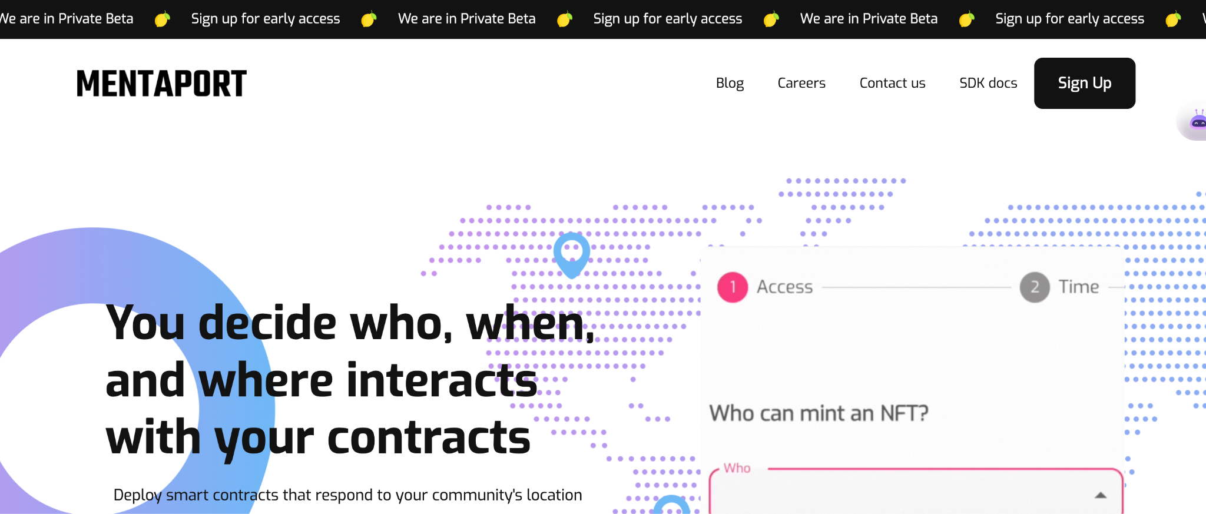
Sui x Developer Tools
Sui landscape consists of multiple developer tool sets helping developers to build upon the SUI Ecosystem.
Some of the Dev. Tool-Sets include:
Online IDE Supporting Move Programming Language (Move IDE)
Platform Enabling the deployment of Location Aware Smart Contracts (Mentaport)
Unity and Unreal Engine SDKs enabling ease of web3 integration within the gaming space (Origin Byte)
Reliable RPC Endpoints for Developers (NodeInfra)
& Multiple Other Ones.

Slide 14
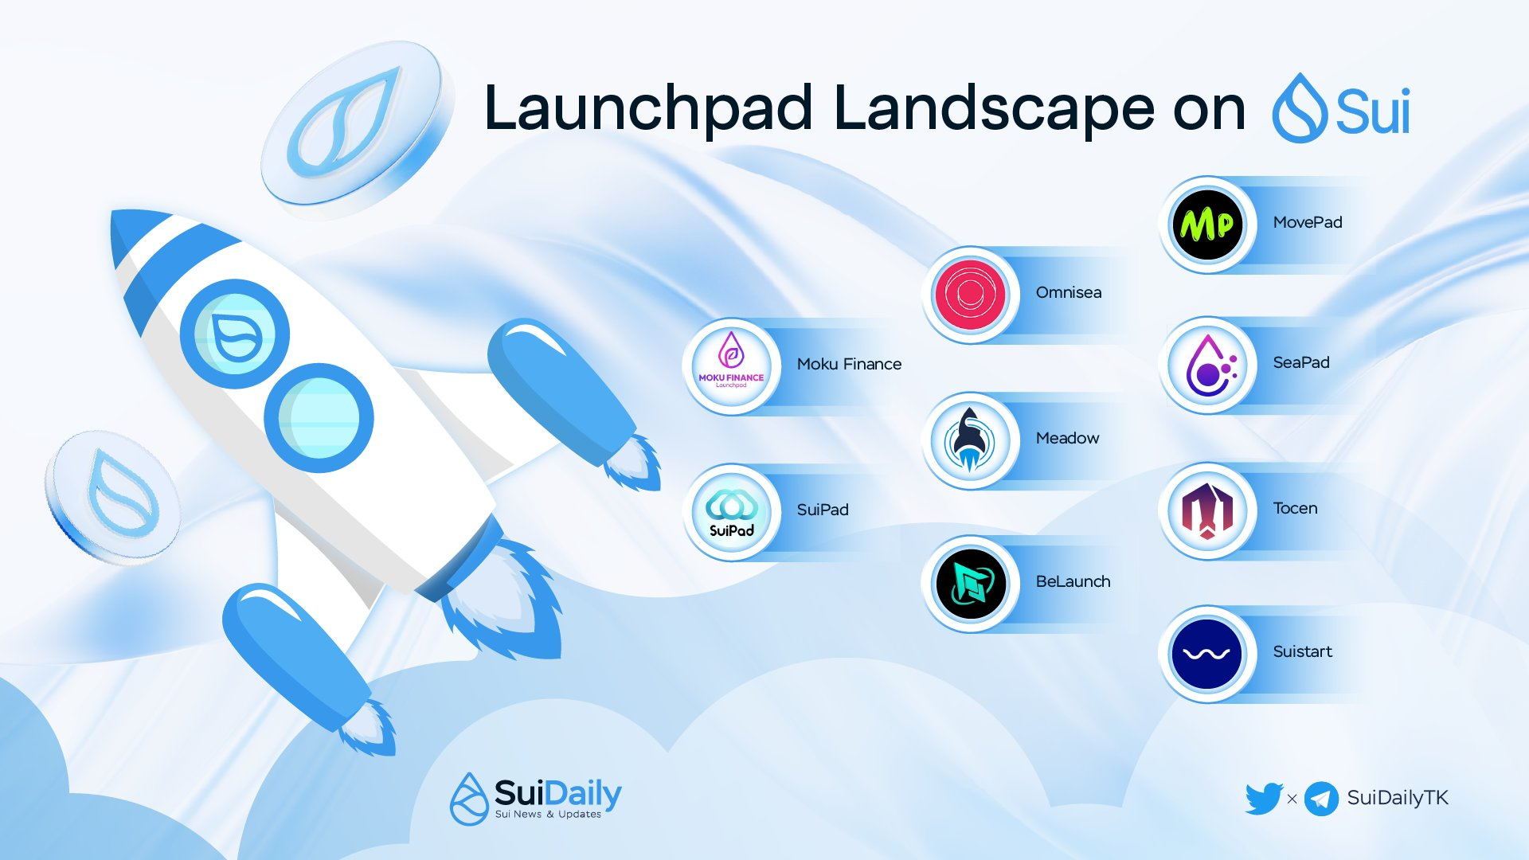
Sui x Launchpads
Since it’s mainnet launch multiple launchpads have been developed supporting new projects and enabling exposure towards potential investors.
Some of the know launchpads:
Suipad, SuiStart, SeaPad, Tocen
Supporting:
Initial Coin Offering
Initial Dex Offering
Initial NFT Offering
Multiple other Features.
+Multiple others

Slide 15
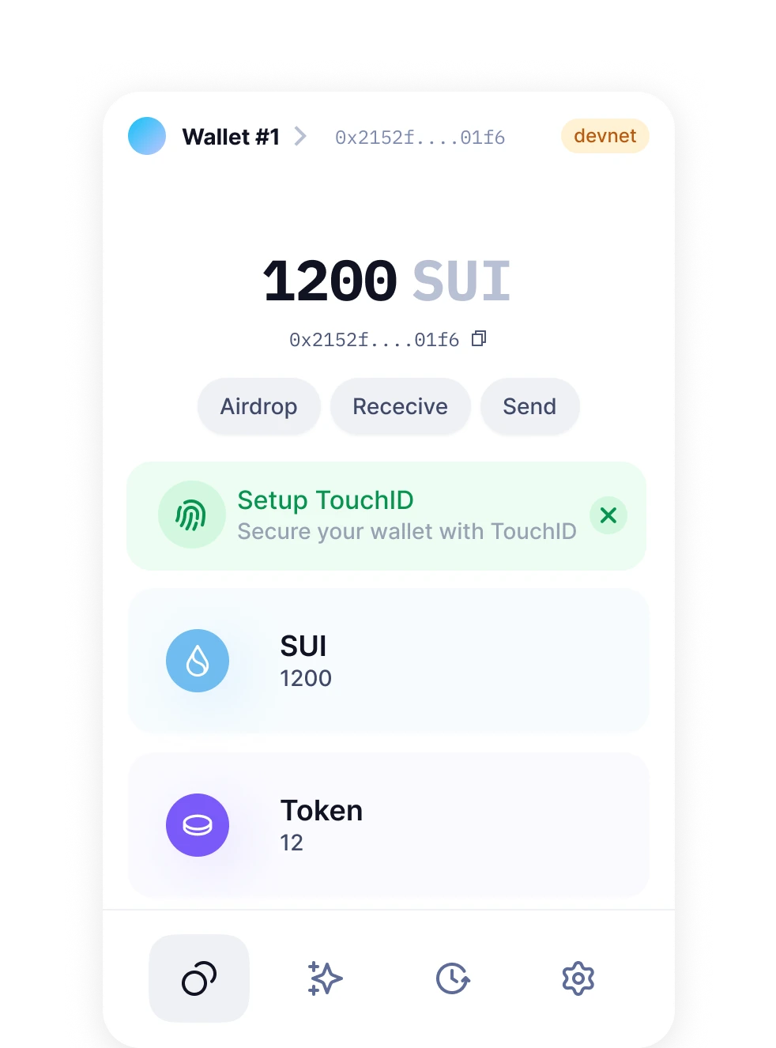
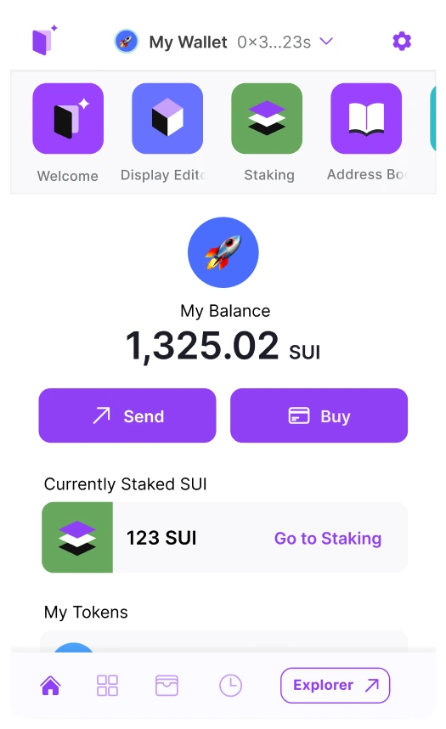
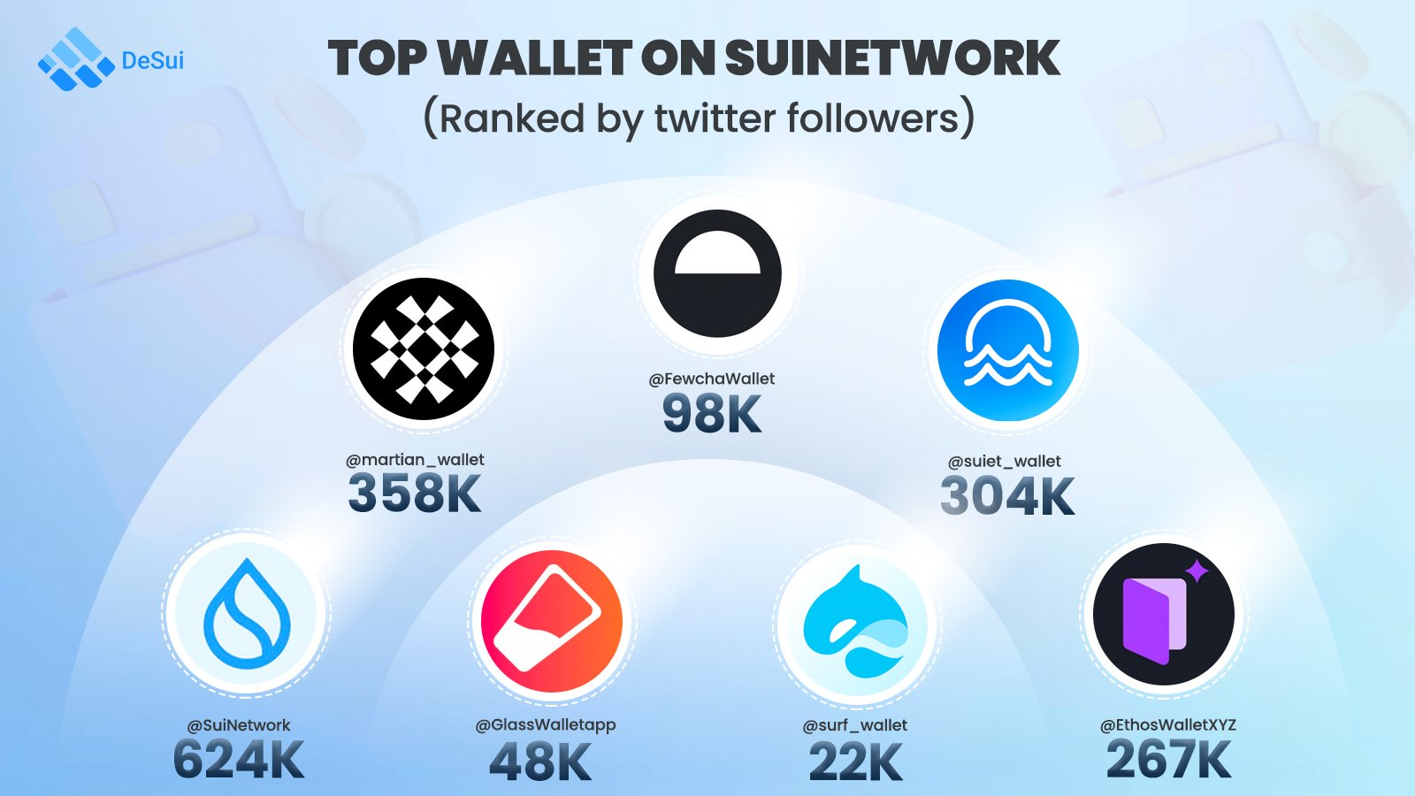
Sui x Wallets
Multiple Wallets enabling ease of onboarding and interaction with different dAAps across the SUI Landscape.
Sui Wallet - Native Open Source Wallet for Developers and User’s alike.
Packed with the developer features.
15+ Wallets Currently Active / Being Built
Supporting:
Email Login
Social Based Login
dAAp discovery
Multi-Sig Feature
& Multiple other features.

Slide 16
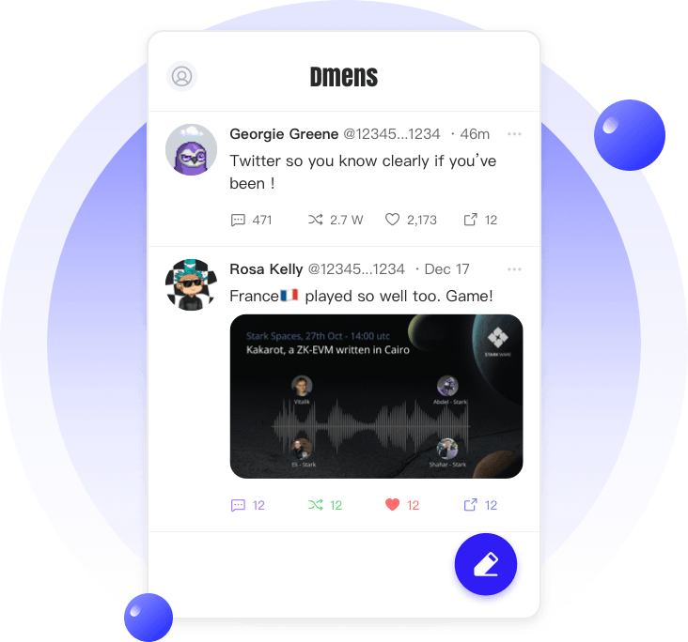
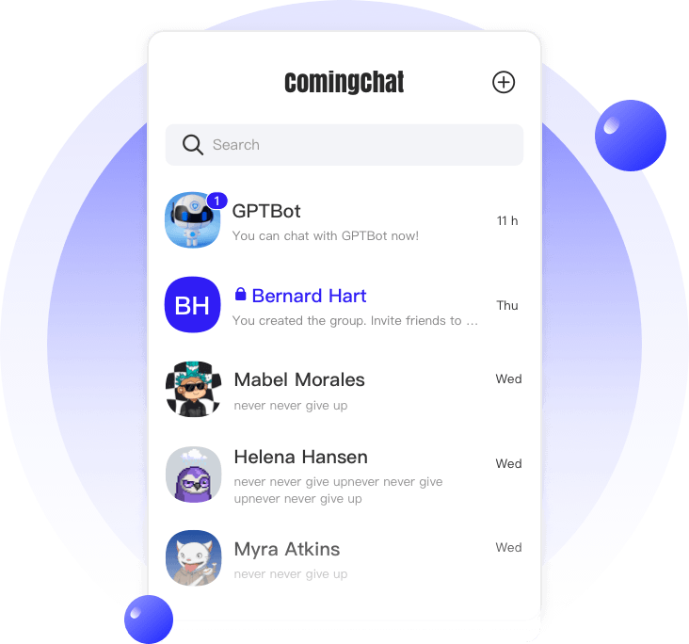
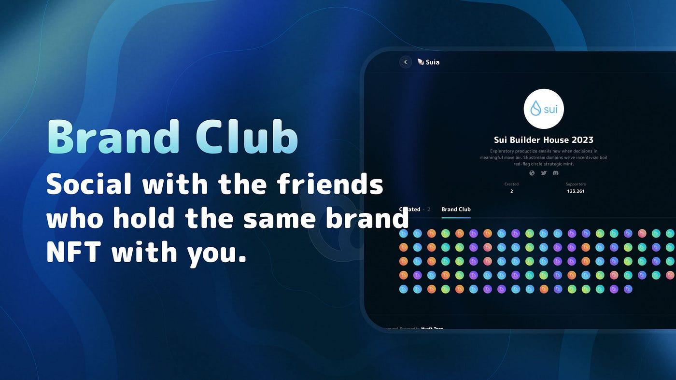
Sui x Social
Due to its interoperability nature, multiple projects have started to built upon the Decentralized Social Media Landscape.
Coming Chat | Sui Name Service | PolyMedia Profile + Chat | Suia.io & others.
Enabling users to:
Browse, Claim .sui domain names
connected with different dAAps.
Collect Proof of Contribution NFT’s created
by different dAAps.
Chat / Socialize and build your
own virtual profiles and reputation.
Connect with users holding the same NFTs.
Explore quests and many other features.

Slide 17




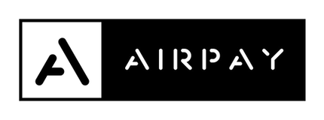

Start building on Sui?
Sui Grant Program
dappium.io
Go SUI SDK
Sui foundation supports builders who building upon the SUI ecosystem and contribute towards growth and adoption.
Dependent on the project scope grants range from $10,000 - $100,000 USD
Grant payments are distributed based upon the milestones completed by the grantee.
$415,000 in grants distributed over the past year.
+Multiple others

